Slide 1
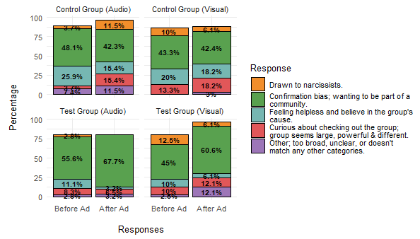
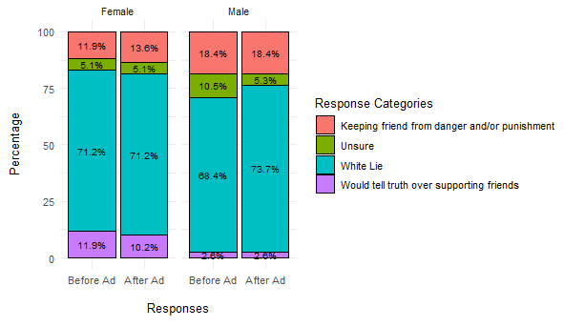
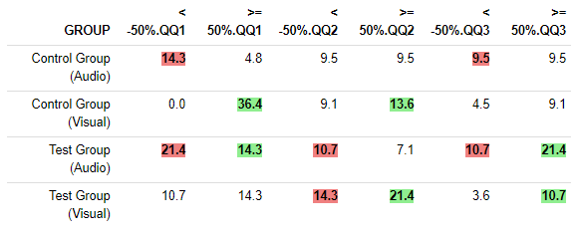
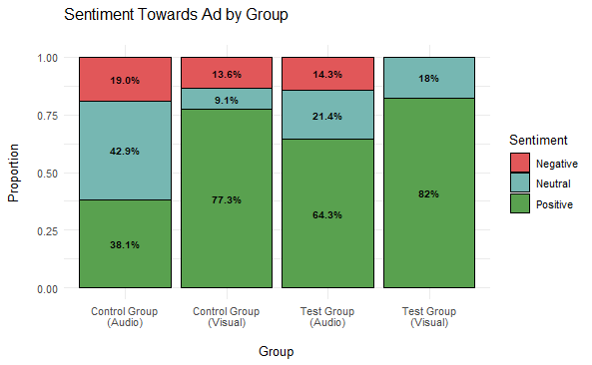

Non-Cognitive Predictors of Student Success: A Predictive Validity Comparison Between Domestic and International Students
Non-Cognitive Predictors of Student Success: A Predictive Validity Comparison Between Domestic and International Students
Combating Misinformation with a Humorous Audio Ad: Extending a Mixed Methods Analysis
PARTICIPANTS
Gender
Female: 59.6%
Male: 46%
Prefer not to say: 2%
Ages
18-19 years old: 24.2%
20-29 years old: 69.7%
30+ years old: 6.1%
Podcast habits
Listens to at least 1 podcast: 47.5%
Does not listen to any podcasts: 52.5%
Ad Skipping Behavior of Podcast Listeners:
Always skips ads: 71.8%
Sometimes skips ads: 26.8%
Never skips ads: 1.4%
RESULTS
Figure 1. QQ1 Top 5 responses (out of 9), by ad group
Kendall Beaver¹, Diana Daley², Kainan Garrett³
¹Graduate Researcher
²Ph.D., Associate Professor, University of Arizona College of Information Science
³Undergraduate Research Assistant
BACKGROUND
Dr. Daley & Kainan developed a humorous audio ad that aimed to make a listener more skeptical about misinformation and increase their information literacy
The ad was split into an audio and visual-audio format for a test group, plus a random ad in the same formats for a control group
99 college students participated in their study and were randomly assigned to 1 of the 4 groups
Participants took 3 tests before and after the ad that measured their tendency to believe misinformation
Comparison of test results found that audio-visual ads led to improved information literacy while audio-only ads produced mixed results
QUESTIONS
Qualitative Questions (QQ)
QQ1: What are some reasons you think people are attracted to radical groups?
QQ2: What are some reasons you think people believe false ideas circulating online?
QQ3: Describe a situation in which supporting friends would be more important than telling the truth.
Questions About Ad
What did you like most about the ad?
What did you like least about the ad?
Please tell us any other thoughts you have about the ad.
Figure 2. QQ3 responses by gender
Table 1. Composite score of QQ1-QQ3,with a difference of + 50% in responses
DISCUSSION
QQ1: 9 main categories were discovered, where the category of “wanting to be part of a community” increased after hearing the test ad of the female character joining a new group of radical friends online (Fig. 1)
QQ3: Females had a higher tendency than men to tell the truth over supporting their friends, while males had a slightly higher chance of protecting their friends from punishment or danger than females (Fig. 2)
Composite score: Visual ads had a 66.67% chance of increasing written responses by at least 50% (Table 1)
Sentiment analysis: Participants had a negative feeling towards audio-only ads, while the test audio-visual ad had the largest positive sentiment 82%, and had no negative sentiment (Fig. 3)
PROJECT OBJECTIVE
The researchers asked the same open-ended questions before and after the ad, but have not had time to thoroughly analyze this qualitative data
Graduate researcher performed thematic analysis on this qualitative data and developed a composite score that measured the change in a participant’s responses after viewing an ad
Results found that the format and content of ad may have subtly influenced the change in responses, but not consistently across all questions
Gender differences revealed contrasting viewpoints in responses
Figure 3. Sentiment towards ad, by group

